Slide 1
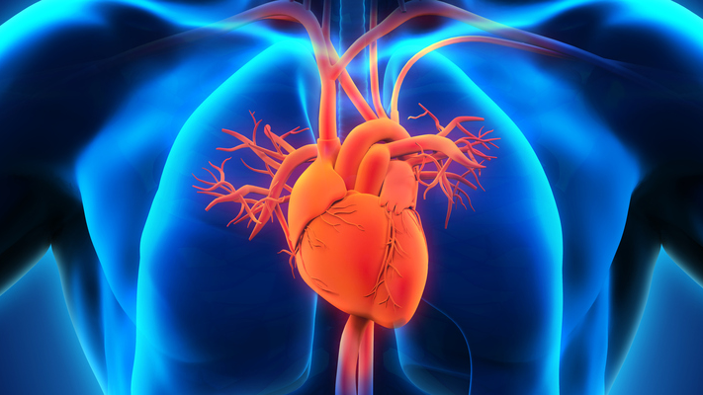


Heart Disease Analysis and Prediction
Harini Lakshmanan
Mohammad Mahmoudighaznavi
Verity Pierson
https://github.com/harinigautham/ADS_503_APM_Heart-Predictions

Slide 2
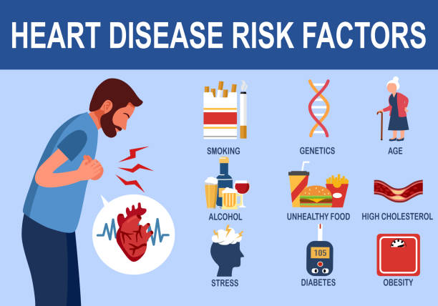
Problem Statement
Realize the top factors increasing risk of heart disease
How these results can help health care providers predict if the patient will have heart disease

Slide 3
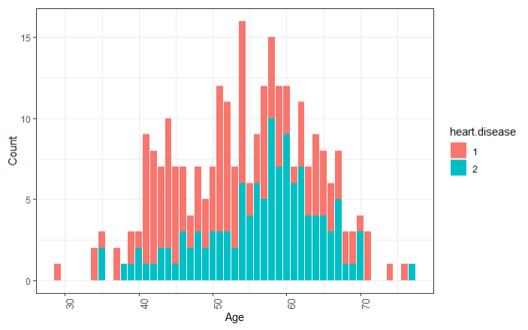
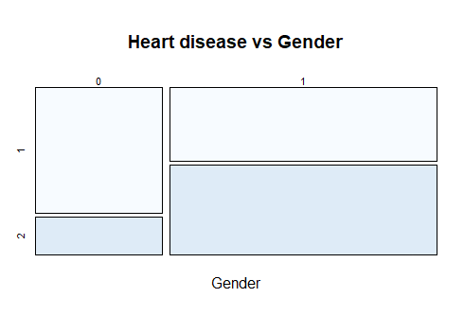
Exploratory Data Analysis (EDA) – Age and Gender
Gender (1 = male; 0 = female)
Diagnosis of heart disease (Absence (1) or presence (2) of heart disease

Slide 4
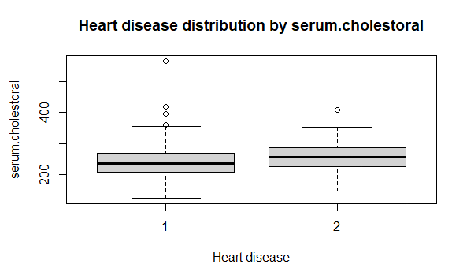
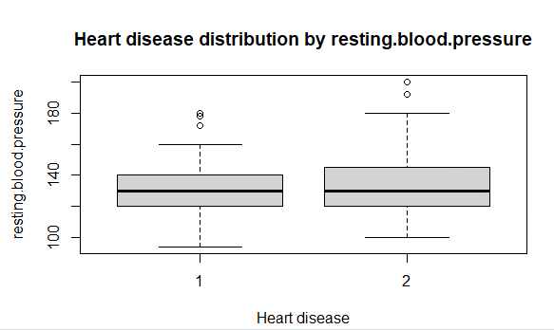
EDA – Blood Pressure and Cholesterol

Slide 5
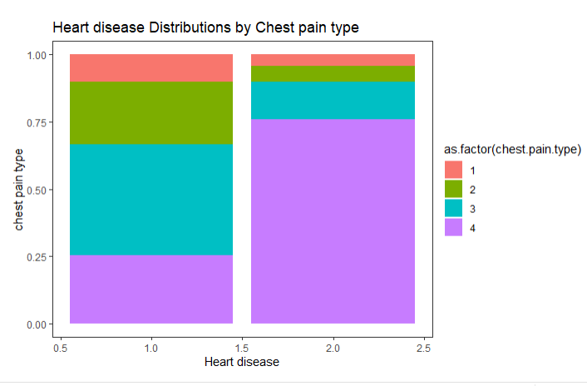

EDA-Chest Pain Type
Value 1: typical angina
Value 2: atypical angina
Value 3: non-anginal pain
Value 4: asymptomatic

Slide 6
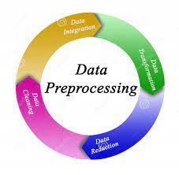
Data Wrangling and Pre-Processing
Dummy Encoding
Age
Gender
Heart disease
Chest Pain Type
Exercise
Missing Values
No missing values
Outliers
No significant outliers

Slide 7
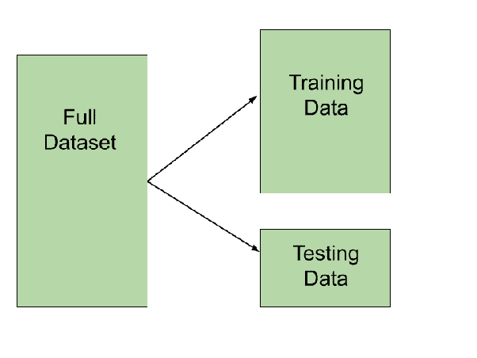
Data Splitting
80% Training Set
216 Records
20% Test set
54 Records

Slide 8
Model Strategies-Part 1
Linear Classification Models
Logistic Regression
Linear Discriminant Analysis
Partial Least Square Discriminant Analysis
Penalized Models
Nearest Shrunken Centroids

Slide 9
Model Strategies-Part 2
Nonlinear Classification Models
Neural Network
Support Vector Machine
K-Nearest Neighbors

Slide 10

Model strategies – Part 3
Classification Trees and Rule-Based Models
Random Forests
Bagged Trees
Gradient Boosting

Slide 11
Results and Final Model Selection
Models | Train Accuracy | Test Accuracy | Sensitivity
LDA | 0.8141 | 0.8519 | 0.9032
Logistic Regression | 0.8152 | 0.8519 | 0.9032
KNN | 0.7823 | 0.8704 | 0.9355
SVM(Linear) | 0.8422 | 0.8519 | 0.9032
SVM (Radial Kernel) | 0.8513 | 0.8519 | 0.9355
MDA | 0.8422 | 0.8519 | 0.9032

Slide 12

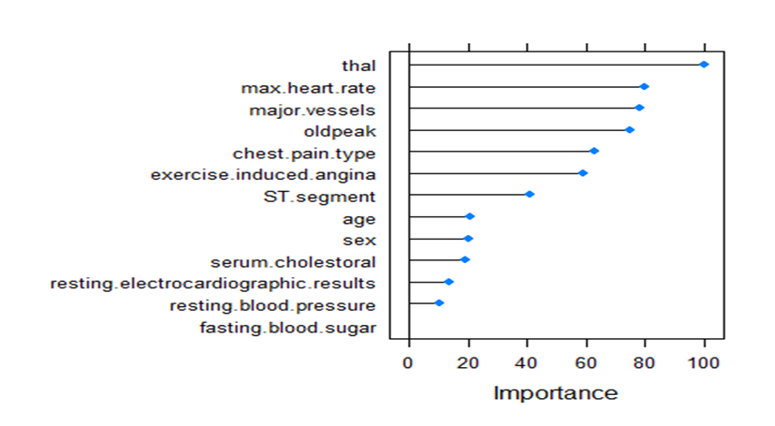
Feature Importance for Final Model

Slide 13

Next Steps
Limited availability of data due to privacy around patient data and hence would love to collaborate with medical associations to gather more resources for such studies
Understand effectiveness of model with increased sample size
Implement additional predictor variables which are critical for heart disease like BMI, family history and smoking characteristics
The model developed can be used as a good baseline for future research in heart disease prediction based on patient characteristics

Slide 14

Thank you

Slide 15
References
K, D. (2023, February 7). Top 4 advantages and disadvantages of support vector machine or SVM. Medium. https://dhirajkumarblog.medium.com/top-4-advantages-and-disadvantages-of-support-vector-machine-or-svm-a3c06a2b107
Narashiman, & Chu. (2002, May 14). Tibshirani.su.domains. https://tibshirani.su.domains/PAM/Rdist/howwork.html#:~:text=After%20shrinking%20the%20centroids%2C%20the,it%20does%20automatic%20gene%20selection.
Ranjan Rout, A. (2023a, January 10). Advantages and disadvantages of logistic regression. GeeksforGeeks. https://www.geeksforgeeks.org/advantages-and-disadvantages-of-logistic-regression/
Yan, Y., Yang, Z., Semenkovich, T. R., Kozower, B. D., Meyers, B. F., Nava, R. G., Kreisel, D., & Puri, V. (2022, January 22). Comparison of standard and penalized logistic regression in risk model development. JTCVS open. https://www.ncbi.nlm.nih.gov/pmc/articles/PMC9390725/

